Slide 1
Class Expansion in Pre-trained Models
Updation of a pre-trained model (final-layer based), if new classes come in the target dataset.
IE643 Course Project
By
Team Wabi-Sabi
Yash Sarang 24M2160 CMInDS

Slide 2
Overview of the contents / Index
Description / Understanding of the Problem
Approaches to solve the problem
Roadmap followed
Timeline of progress
Summary of work done before the prep presentation project review
Description of work done after prep presentation review using bullet points.
Dataset and Data Preprocessing
Experimental Setup and Details
Experimental Results (Qualitative and Quantitative)
Conclusions
Future plan for the completion of the project task
References / Bibliography
Future scope for the project task
Plan for Novelty Assessment

Slide 3
Description of the task
Understanding of the task
Classification task for a dataset with a slightly small (upto 20) number of classes . The number of classes in the dataset is assumed to be known.
Free to take the data as labeled or unlabeled as per convenience. (Labeled datasets considered in this project)
The model is trained on a subset of dataset which does not contain samples from all labels.
Now, when introducing a few more unknown classes of the dataset, the classifier head of the model will need to be updated for the total set of classes (considering that the number of unseen classes is known).
Exploring / Discovering optimal methods to update the last layer of a classifier model, wherein new classes will arrive.

Slide 4
Proposed Approaches to solve
1. Use of a Flexible Neural Network Architecture (Fixed Representation)
-> Naive Change
-> Final Layer Retraining
-> Transfer Learning (Upper-bound solution of this problem)
2. Fine-tuning with knowledge distillation Also known as Learning without Forgetting approach
3. Other DL based approaches: -> Regularization-based Approaches (Elastic Weight Consolidation - EWC) -> Meta-Learning or Few-Shot Learning
4. Incremental Learning Models (ML based)
-> Learn++ Algorithm for increment learning -> CatBoost with Boosting

Slide 5
Workflow - PS to task completion
Project Allocation (21 Aug, 2024)
Implement and evaluate methods for pre-trained model class expansion
Select datasets: MNIST, CIFAR-10 dataset as benchmark
Research potential Deep Learning based approaches
Choose initial approaches to test: Basic Benchmarking, Naive Change, Final Layer Retraining, Transfer Learning.
Preparatory Phase (21 Aug - 23 Sept, 2024)
Pre Prep Presentation Phase (23 Sept - 23 Oct, 2024)
Reading Relevant material during the exploration
Background materials read to understand the problem
Implement Naive Change, Flexible Neural Network Architecture, Transfer Learning, Final Layer Retraining
Early Testing: Assess initial results and identify main obstacles
Initial documentation of strengths and weaknesses for each approach
Post Intensive Assessment Phase (24 Oct - 3 Nov, 2024)
Research incremental learning techniques & Check for any Deep Learning based implementations
Choose initial methods to test: Regularization-based, Meta-Learning, Knowledge Distillation, CatBoost with Boosting, Meta-Learning, Learn++ Algorithm, Elastic Weight Consolidation
Check for any Further refinement and optimization of methods & Implement as many methods as possible
Evaluate on catastrophic forgetting metrics across methods
Conduct comparative performance evaluation on MNIST dataset
Pre-Novelty Assessment Phase (3 Nov 2024 onwards)
Integrate and refine the top-performing working models.
Create a Interactive web application using Streamlit explaining the given problem
Also implement a gamified version of quizzes midways based on the results observed
Conduct final performance assessment with a focus on real-world applicability
Prepare documentation for final reporting and presentations

Slide 6
Summary of work done before Prep Presentation
Preparatory Phase (21 Aug - 23 Sep 2024)
Project Goals Definition:
Established primary objectives for the project, focusing on developing and evaluating methods for incremental learning to accommodate new classes in pre-trained models.
Dataset Selection:
Selected MNIST and CIFAR-10 datasets as benchmarks for experimentation due to their suitability for testing class expansion methods, providing a range of complexity in visual classification tasks.
Research on Deep Learning Approaches:
Conducted a foundational review of various deep learning techniques applicable to incremental learning, particularly focusing on solutions to avoid catastrophic forgetting.
Initial Approach Selection:
Identified initial methods for implementation:
Basic Benchmarking: Establishing a baseline performance without modifications.
Naive Change: Testing the direct integration of new classes without any specialized approach.
Final Layer Retraining: Updating only the final layer to integrate new classes, keeping prior representations fixed.
Transfer Learning: Leveraging pre-trained features to extend knowledge to new classes with minimal re-training.

Slide 7
Pre-Prep Presentation Phase (23 Sept - 23 Oct 2024)
Literature and Background Exploration:
Undertook extensive reading of relevant materials, including research papers on incremental learning, transfer learning, and techniques to mitigate catastrophic forgetting.
This exploration provided a solid theoretical foundation for selecting and implementing methods effectively.
Implementation of Initial Approaches:
Developed and implemented the following approaches:
Basic Benchmarking: Established baseline results for comparison.
Naive Change: Tested simple integration to identify potential issues.
Transfer Learning: Applied transfer learning techniques to adapt the model’s representations to include new class data.
Final Layer Retraining: Implemented by updating the last layer only to accommodate new classes.
Early Testing and Evaluation:
Conducted initial tests on all implemented approaches to observe their performance and effectiveness in class expansion.
Assessed each approach on metrics such as accuracy retention, computational efficiency, and initial observations on catastrophic forgetting.
Documentation of Strengths and Weaknesses:
Documented observations from each approach, noting:
Strengths: For example, Transfer Learning adaptability and Final Layer Retraining minimal computational cost.
Weaknesses: Challenges in retaining knowledge of previous classes with Naive Change and issues with flexibility in Basic Benchmarking.

Slide 8
Summary of work done after Prep Presentation
Post Intensive Assessment Phase (24 Oct - 3 Nov 2024)
Researched various incremental learning techniques to expand on previous findings.
Explored Deep Learning implementations for enhancing model adaptability to new classes.
Selected and tested advanced methods:
Regularization-based approaches, Meta-Learning, Knowledge Distillation, CatBoost with Boosting
Learn++ Algorithm, Elastic Weight Consolidation
Conducted further refinement and optimization of implemented methods to improve performance.
Implemented as many selected methods as feasible within the phase.
Evaluated each method on catastrophic forgetting metrics to assess knowledge retention.
Performed a comparative performance evaluation on the MNIST dataset to identify the most effective
methods.
Pre-Novelty Assessment Phase (3 Nov 2024 onwards)
Integrated and refined the top-performing models from the intensive assessment phase.
Developed an interactive web application using Streamlit to explain the project problem and solution Approaches.
Incorporated a gamified component with quizzes to engage users on the results and findings.
Conducted a final performance assessment, emphasizing real-world applicability and robustness of the Methods.
Prepared comprehensive documentation for final reporting and presentations.
Outlined a future research roadmap to explore further advancements in incremental learning and model resilience.

Slide 9
Dataset and Data Preprocessing
MNIST Dataset
The MNIST dataset is a collection of 70,000 handwritten digits (0-9) commonly used for training various image processing systems. It contains 60,000 training images and 10,000 testing images, each of size 28x28 pixels.
Given the dataset's size and diversity, you may have sufficient samples for fine-tuning, but be mindful of data augmentation techniques to improve model robustness against new styles.
CIFAR-10 dataset
CIFAR-10 consists of 60,000 - 32x32 color images in 10 different classes, with 6,000 images per class. The classes include airplanes, cars, birds, cats, deer, dogs, frogs, horses, ships, and trucks​ The dataset is divided into 50,000 training images and 10,000 testing images, which is standard for training and evaluating machine learning models​.
Each class in the dataset is distinct and does not overlap with others, ensuring clear classification tasks​’. Due to its balanced distribution and moderate size, CIFAR-10 is popular in academic and research settings for benchmarking algorithms in image recognition and computer vision​.

Slide 10
Data Preprocessing
To organize and streamline our classification tasks, we partitioned the data into specific subsets as follows:
• Full: Includes all labels from 0 to 9, representing the entire dataset.
• Low: Contains labels 0 to 7.
• High: Contains labels 8 and 9.
We created the following variables to represent different data splits:
x train full, x test full Represent the original full training and testing datasets
x train, x val Subdivided datasets used for training and validation purposes.
x train low, x train high Data subsets used specifically for training on Low and High class labels
x test low, x test high Data subsets used specifically for testing on Low and High class labels
x val low, x val high Data subsets used specifically for validation on Low and High class labels
y train full, y test full Represent the original full training and testing datasets
y train, y val Subdivided datasets used for training and validation purposes.
y train low, y train high Labels for the Low and High subsets within the training dataset.
y test low, y test high Labels for the Low and High subsets within the testing dataset.
y val low, y val high Labels for the Low and High subsets within the validation dataset.
Purpose of Data Splits
The partitioning into Full, Low, and High subsets allowed us to experiment with class-incremental learning
methods by selectively introducing new labels over time. Specifically, starting with the Low label subset
and incrementally adding the High labels simulates the introduction of novel classes into the model. This
setup is critical for examining model performance under incremental class learning and understanding its
capability to retain learned knowledge without retraining from scratch.

Slide 11
Experiment Setup
Hardware configuration:
• Processor: AMD Ryzen 7 7745HX
• GPU: NVIDIA GeForce RTX 4060 Laptop GPU
• Memory: 16 GB RAM
• Operating System: Windows 11 - Version 23H2
• Frameworks: PyTorch 2.4.0 for deep learning experiments and CatBoost 0.26 for incremental boosting experiments.
• Environment - Google Colab
Optimization Settings and Hyperparameters:
• Optimization Algorithm: Adam optimizer for most experiments, due to its adaptive learning rate capabilities, with a learning rate of 0.005 for initial training and fine-tuning steps.
• Batch Size: A batch size of 32 was used across experiments, balancing memory usage and computational efficiency.
• Transfer Learning Phase Settings: For transfer learning experiments, the final two layers were fine-tuned for 10 epochs before retraining the entire model for 20 additional epochs with a reduced learning rate of 0.0001.
• Knowledge Distillation Data Ratio: Knowledge distillation experiments retained 10% of the original data when fine-tuning with new classes to minimize forgetting.
Although, these are the final Hyperparameters, we have fixated on, we also have played around a lot with
them especially with the number of epochs, and various distributions of data or methods of retraining for
the Flexible Neural Network Approach.

Slide 12
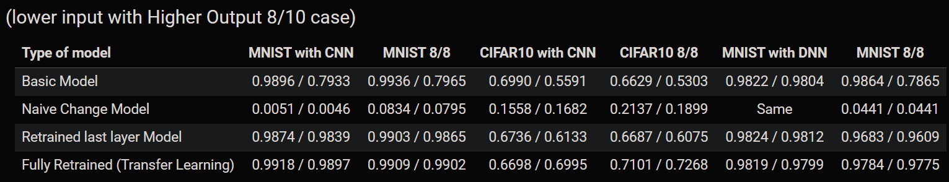
Experiment Results
Training Procedure and Algorithm
• Flexible Neural Network Architecture: A neural network architecture where the output layer was incrementally expanded to accommodate new classes.
Identified initial methods for implementation: Basic Benchmarking: Establishing a baseline performance without modifications. Naive Change: Testing the direct integration of new classes without any specialized approach. Final Layer Retraining: Updating only the final layer to integrate new classes, keeping prior representations fixed. Transfer Learning: Leveraging pre-trained features to extend knowledge to new classes with minimal re-training.
Above figure shows the outputs of all the various experiments tried on the Flexible Network Architecture.
It encompasses all various types of training experiments of changing the model sizes, and trying to implement incremental learning on them.

Slide 13
1. Use of a Flexible Neural Network Architecture (Fixed Representation)
Extend the output layer: Add new neurons to the output layer to accommodate the new classes, preserving the original output neurons for existing classes.
Accuracy for label 0: 98.88%
Accuracy for label 1: 99.30%
Accuracy for label 2: 98.26%
Accuracy for label 3: 98.91%
Accuracy for label 4: 99.08%
Accuracy for label 5: 97.42%
Accuracy for label 6: 98.54%
Accuracy for label 7: 96.89%
Accuracy for label 8: 0.00%
Accuracy for label 9: 0.00%
Total accuracy: 78.91%
Considering a MNIST dataset on a
DNN based Architecture
Benchmarking for model trained on 8 out of 10 classes (0-7)
Test accuracy for older dataset: 0.9842
Test accuracy for whole dataset: 0.7891
Reinitialize and train only the new neurons: Initialize the weights connecting to the new neurons, while freezing or keeping the weights connected to the original classes. Train only on samples of the new classes while retaining performance on the old ones through transfer learning.
After adding a 10 neuron layer instead of initial 8 neuron layer
New neuron weights initialised with : Normal Weight Distribution / Zeroes
Test accuracy for older dataset: 0.4042 / 0.9842
Test accuracy for whole dataset: 0.4377 / 0.7890
Conclusion : Doesn’t perform any better but might perform significantly worse
Deep Shallow Incremental Learning (DeeSIL) is the most popular which makes use of a deep fixed representation.

Slide 14
Upper Bound for our topic -
1.2 Implement Transfer Learning
Transfer learning is to be applied if we don’t want to alter the model structure drastically.
We create a two-phase training process: First, fine-tune the last few layers with the new class data and then retrain the model with a combined dataset of old and new classes.
Basically same as training a model from scratch, but it trains and converges faster due to having suitable weights to adapt for the previous trained classes.
Test accuracy over 0-7 dataset: 0.9936, Test loss acc: 0.0291
Test accuracy over whole dataset: 0.7965, Test loss acc: nan
Test accuracy over 0-7 dataset: 0.9908, Test loss acc: 0.0427
Test accuracy over whole dataset: 0.9901, Test loss acc: 0.0441

Slide 15
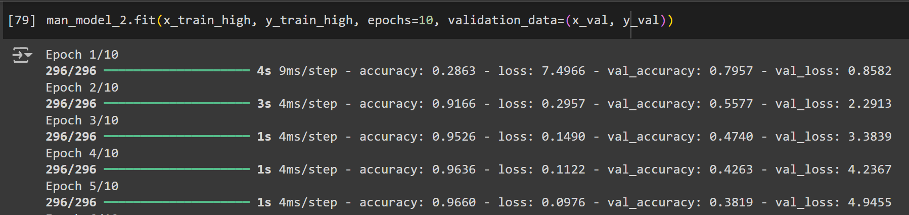
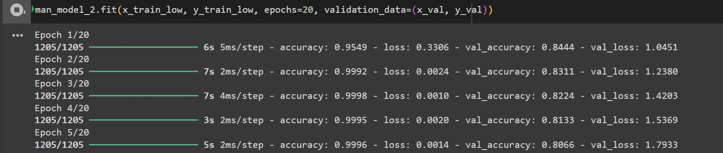
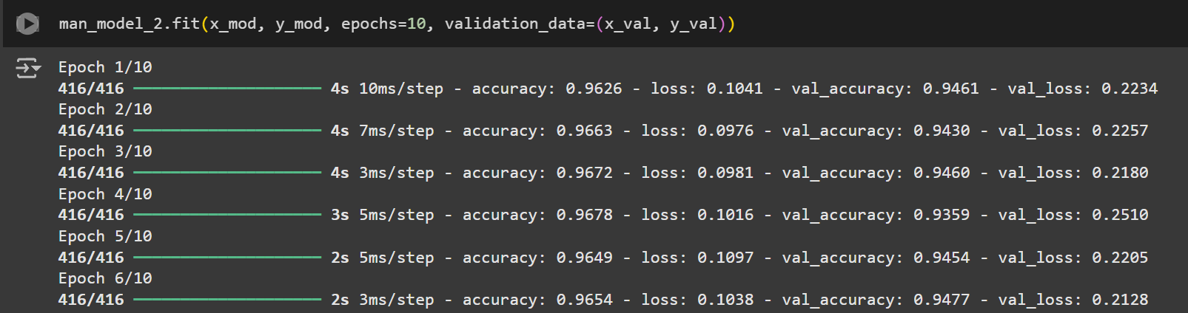
2. Fine-tuning with knowledge distillation
Fine-tune the expanded classifier head with both the original and new data.
On training the model with only the newer data, it tends to perform very poorly on the initial classes
Model overfits on the newer classes and forgets the initial classes to be classified
The inverse is also true.
By maintaining a proper ratio of the new data and older data, the forgetting can be minimised. Considered 10% of original data below
Conclusion: Catastrophic forgetting of previously learned classes if only the classifier head is fine-tuned with new data.
(previous layers freezed)
Incremental Classifier and Representation Learning (ICaRL) is the most popular in this category.

Slide 16
3. Other DNN based approaches include: Regularization-based Approaches (Elastic Weight Consolidation, EWC)
Add a regularization term to the loss to prevent drastic changes to the weights associated with the original classes. Uses a regularization term that penalizes deviations in weights that are critical to the performance on known classes. Techniques like Elastic Weight Consolidation (EWC) assign importance to weights based on their significance to the prior tasks.
Helps in mitigating catastrophic forgetting, allowing incremental updates without severe performance degradation.
Cons: Requires fine-tuning of regularization strength and doesn’t scale well to a large number of incremental updates. Wasn’t able to properly implement it, faced evaluation errors
Meta-Learning or Few-Shot Learning
few-shot learning: This approach can help the model adapt to new classes with only a small amount of data per class.
Meta-learning techniques like prototypical networks can be ideal in scenarios where new classes come in frequently and require rapid adaptation without fully retraining the model.
Meta-learning and few-shot learning approaches were beneficial for limited data scenarios but showed reduced performance under frequent class updates. (According to literature reviews)

Slide 17
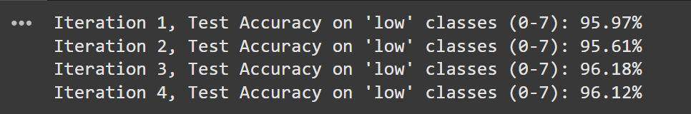

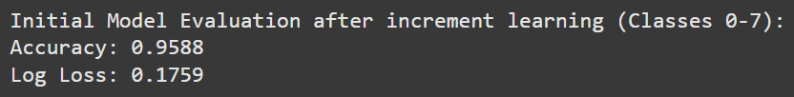

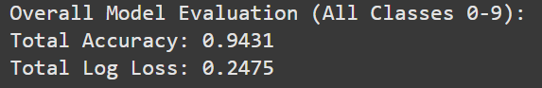
Learn++ Algorithm for increment learning
4. Incremental Learning Models
Incremental construction of support vector machine classifiers, Incremental learning based on reproducible kernel Hilbert spaces, incrementally adding new IF–THEN rules to an existing fuzzy inference system require either precise a priori knowledge of data distributions, or an ad-hoc selection of a large number of parameters
ARTMAP algorithm generates decision clusters in response to new patterns, different from previously seen instances, previously generated clusters are always retained,
It had a vigilante parameter which is typically chosen in an ad hoc manner by trial and error, Hence unreliable
Learn++ solved all these problems, and gave great results overall while ensuring incremental improvements.
CatBoost with Boosting
Some machine learning models support incremental learning natively, which can handle class additions more naturally:
Incremental training with CatBoost or XGBoost: Tree-based models with boosting allow you to add more data progressively, making them inherently suitable for adjusting to new classes.

Slide 18
Conclusions
The results indicate that transfer learning, knowledge distillation, and incremental boosting methods provided the most robust performance for class-incremental learning tasks. Specifically:
• Transfer learning and knowledge distillation methods effectively mitigated catastrophic forgetting with balanced data from old and new classes.
• Regularization-based methods, though useful in reducing weight drift, required precise tuning and were less scalable with frequent updates.
• Meta-learning and few-shot learning approaches were beneficial for limited data scenarios but showed
reduced performance under frequent class updates. (According to literature reviews)
• Overall, boosting-based incremental methods (such as CatBoost) achieved consistent accuracy across
updates, proving to be the most adaptable for continuous class addition.
• In terms of Neural Networks, Weight Distillation and Final Layer Retraining were the closest to reach the upper-bound of Transfer Learning.

Slide 19
Plan for Novelty Assessment (1 slide)
The Novelty Assessment will focus on practical applications, audience engagement, and comprehensive presentations. Our plan involves preparing interactive materials, and showcasing our methods through a live demo and poster presentation. Below is the structured approach for each component of the Novelty Assessment.
Interactive Web Application for Audience Engagement
• Streamlit Web Application: Interactive web application using Streamlit to explain the project problem, objectives, and methods in a user-friendly manner. This application will allow the general audience to interact with our models, understand the problem, and pique their interest.
• Gamified Quizzes: To engage the audience further, we will implement gamified quizzes within the
application. These quizzes will be based on the results and findings from our experiments, allowing
users to test their understanding of the incremental learning challenges and solutions.
Poster Presentation and Live Demonstration
• Poster Design and Content: A poster will be designed to visually communicate our project’s key
components, methodologies, and results to a general audience. The poster will focus on clarity and
engagement, making complex CIL concepts accessible to all viewers.
• Live Demo: During the poster presentation, we will offer a live demonstration of our CIL models in
action. This demo will showcase how our models incrementally learn new classes in real-time, adapting
to new information without losing prior knowledge. The demo will illustrate the effectiveness of our
approaches, providing tangible insights into their potential real-world applications.
Future Roadmap and Research Directions
• Future Directions: Based on our findings, we will outline a roadmap for future research in CIL, iden-
tifying potential improvements, hybrid approaches, and applications in emerging fields. This roadmap
will serve as a foundation for extending our work and exploring new challenges in incremental learning.

Slide 20
References
Prep
J. Zhang, F. Li, H. Wu and F. Ye, "Autonomous Model Update Scheme for Deep Learning Based Network Traffic Classifiers," 2019 IEEE Global Communications Conference (GLOBECOM), Waikoloa, HI, USA, 2019, pp. 1-6, doi: 10.1109/GLOBECOM38437.2019.9014036. keywords: {Machine learning;Databases;Cryptography;Training;Computational modeling;Payloads;Machine learning algorithms},
J. Zhang, F. Li, F. Ye and H. Wu, "Autonomous Unknown-Application Filtering and Labeling for DL-based Traffic Classifier Update," IEEE INFOCOM 2020 - IEEE Conference on Computer Communications, Toronto, ON, Canada, 2020, pp. 397-405, doi: 10.1109/INFOCOM41043.2020.9155292.
https://stackoverflow.com/questions/50366160/re-train-model-with-new-classes?rq=3 Related section has more similar failed results.
https://www.tensorflow.org/hub/tutorials/tf2_image_retraining
https://scikit-learn.org/stable/auto_examples/datasets/plot_iris_dataset.html
https://en.wikipedia.org/wiki/MNIST_database
Weiss, K., Khoshgoftaar, T.M. & Wang, D. A survey of transfer learning. J Big Data 3, 9 (2016). https://doi.org/10.1186/s40537-016-0043-6
Intensive-Assessment
Awesome Incremental Learning / Lifelong learning, Survey / Papers - https://github.com/xialeiliu/Awesome-Incremental-Learning by Xialei Liu
D. Yu, X. Zhang, Y. Chen, A. Liu, Y. Zhang, P. S. Yu, and I. King, "Recent Advances of Multimodal Continual Learning: A Comprehensive Survey," IEEE Transactions on Neural Networks and Learning Systems.
https://github.com/chiachii/Learn.NSE-Algorithm/ by Chiachii Liang
R. Polikar, L. Upda, S. S. Upda, and V. Honavar, "Learn++: An Incremental Learning Algorithm for Supervised Neural Networks," IEEE Transactions on Systems, Man, and Cybernetics, Part C (Applications and Reviews), vol. 31, no. 4, pp. 497-508, Nov. 2001.
Zhou, Da-Wei & Wang, Qi-Wei & Qi, Zhi-Hong & Ye, Han-Jia & Zhan, De-Chuan & Liu, Ziwei. (2024). Class-Incremental Learning: A Survey. IEEE transactions on pattern analysis and machine intelligence. PP. 10.1109/TPAMI.2024.3429383.
https://github.com/zhoudw-zdw/CIL_Survey/ - by Da-Wei-Zhou
Eden Belouadah, Adrian Popescu, Ioannis Kanellos, A comprehensive study of class incremental learning algorithms for visual tasks, Neural Networks, Volume 135, 2021, Pages 38-54, ISSN 0893-6080, https://doi.org/10.1016/j.neunet.2020.12.003.

